Slide 1
New York Analysis for JUmpMen23
By: Dan Connelly

Slide 2
Methods for Achieving Growth: Looking at Lesser Days
50% of orders come on Friday, Saturday, Sunday
This is a statistically significant part of the data
There are growth opportunities for Monday through Thursday

Slide 3
Methods for Achieving Growth: Time SpenT At Pickup
It is a relatively even split between getting to pickup, time spent at pickup and going from pick up to delivery
Optimizing order and driver times to reduce driver time waiting would reduce customer wait times. This would allow us to take in more orders and improve customer experience.
For this market, incentivizing jumpmen to use certain vehicles such as scooters, van, and bicycles could result in faster deliveries. See chart on next slide
We could also adjust range for deliveries on vehicles dynamically by time taken to deliver.

Slide 4
Time Spent AT pickup: cont.

Slide 5
Methods for Achieving Growth: Repeat Customers
Currently customers average 1.87 orders per month.
The median customer only has 1 order per month, with over half only having 1 order per month.

Slide 6
Methods For Achieving Growth: Optimization of Vehicles
Currently vehicles used for Jumpmen are not optimized with walkers sometimes taking longer trips than motorized vehicles and bicycles.
This is inefficient, but with greater prioritization of vehicle type based on distance from pickup to dropoff, deliveries could be made faster
We can see this in the maps of walker trips and van trips. See next slide for maps.

Slide 7
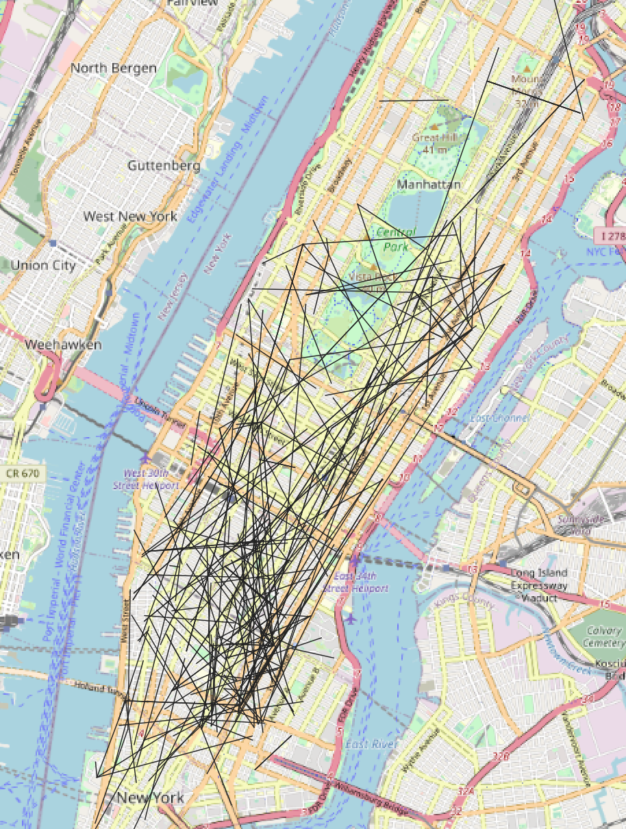
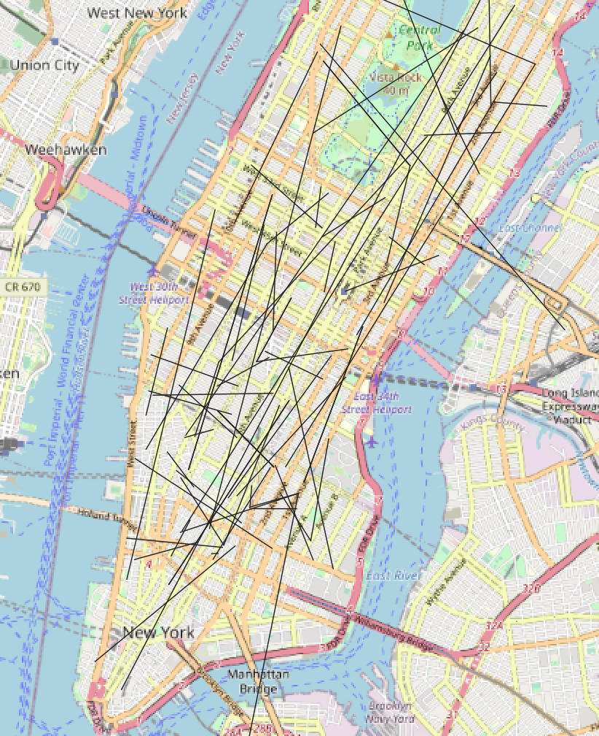
Methods For Achieving Growth: Optimization of Vehicles cont.
Map of Walker Trips
Map of Van Trips

Slide 8
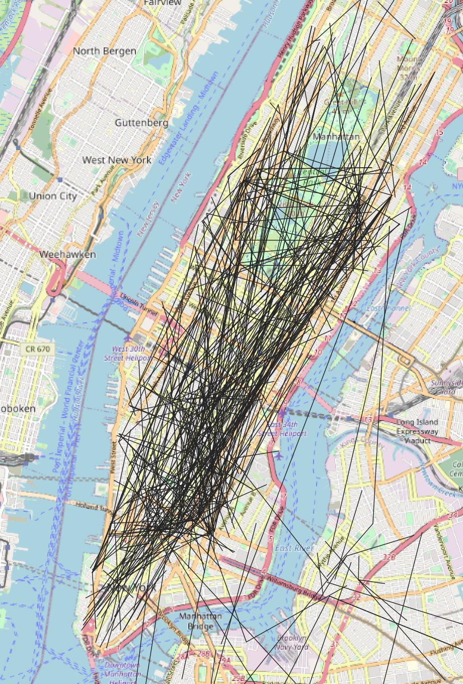
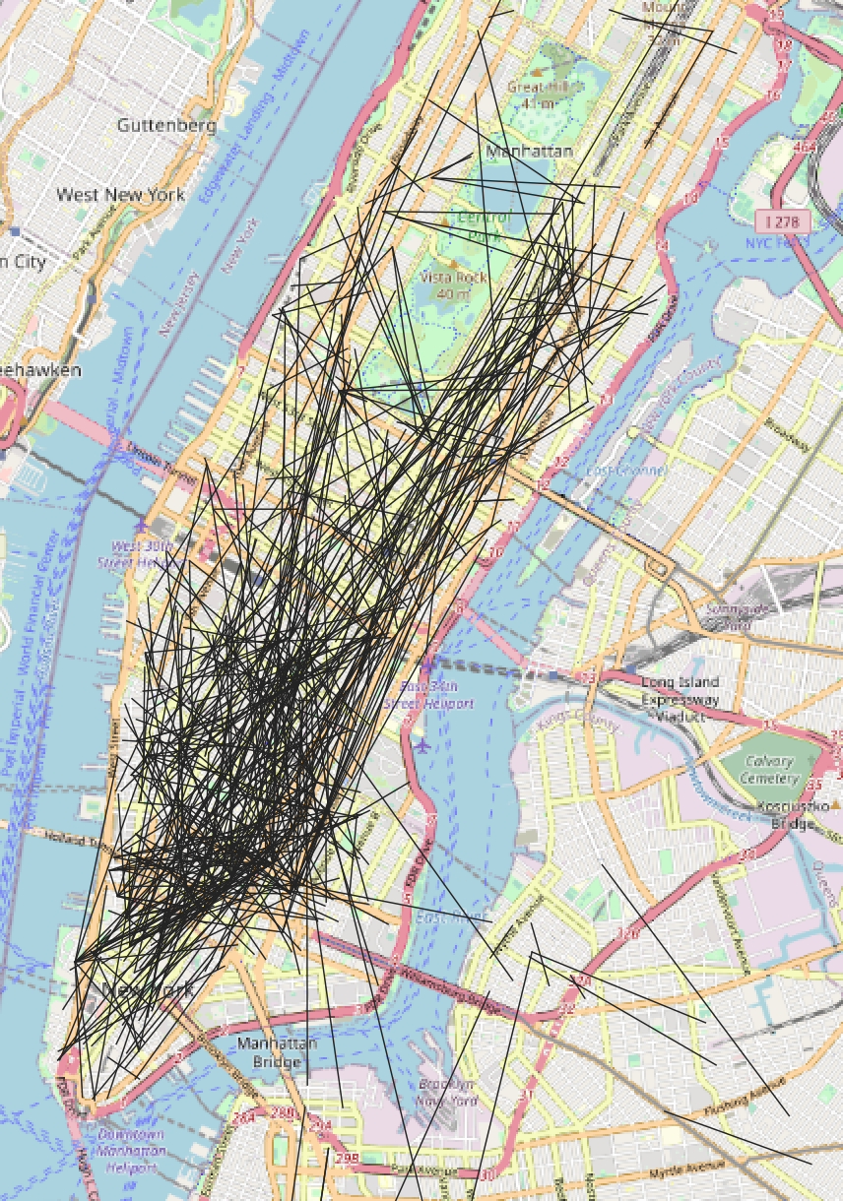
Methods For Achieving Growth: Optimization of Vehicles cont.
Map of Sample of Car Trips
Map of Bicycle Trips
Note: These two were sampled for increased visual clarity.

Slide 9
Data Integrity Issues
Missing Time Stamps for Pick-up and Drop-off Times
This reduces the power of analysis on these values
Missing Item Categories and Quantities from restaurants
This makes it more difficult to sort through what was ordered
Greater standardization and combining of categories would lead to quicker and more efficient analysis in the future.
Example: “Beverages”, “Drinks”, “Other Beverages”, and “Teas and Drinks” could be combined

